Slide 1


TECH DIAMONDS
Fit your people in the team where they sparkle brightest
Jeroen Bijlsma
FOUNDER / CEO

Slide 2

Elevator pitch
TechDiamonds Develops a web-based tool That helps large companies like ING Hold on to their most valuable IT people By letting them move to the team where they are happiest and most productive
Jeroen Bijlsma
FOUNDER / CEO
Notes:
As a freelance software developer for the past 15 years I have heard many managers complain how hard it is to find skilled IT people. Strangely enough I have seen many skilled IT people at those very same companies who were unhappy and unproductive.
IT staff has one of the highest turnover rates in the industry at around 12%. A large Dutch bank like ING group has around 8000 IT people. If we estimate the replacement cost of a single person somewhat conservatively at 25000 per person, that means the yearly turnover cost of IT staff alone is close to 25 million euros. Due to COVID turnover has been relatively low last year, but it is likely to rise significantly once COVID is behind us.
My company - TechDiamonds –
Develops software
That helps large companies hold on to their most valuable IT people By letting them move to the team where they are happiest and most productive
At the moment I have completed a basic MVP that helps teams advertise themselves.
I am looking for someone who can sell the idea to large companies, so we can improve the product together. Some help in coming up with a viable business model would also be nice.
So, who is ready to fit all those Tech Diamonds where they shine brightest?

Slide 3

problem
IT talent is difficult to find
High turnover
Replacing people is costly
The best people are more likely to leave
People can be persuaded to stay
For the best people financial compensation is NOT most important

Slide 4
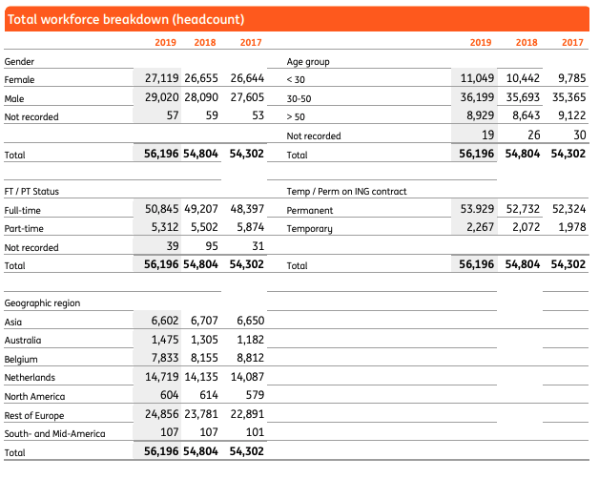
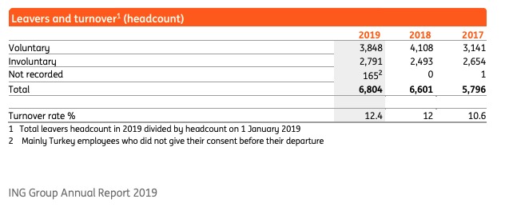
ING Employee FIGURES
Source: 2019 Annual report ING group

Slide 5
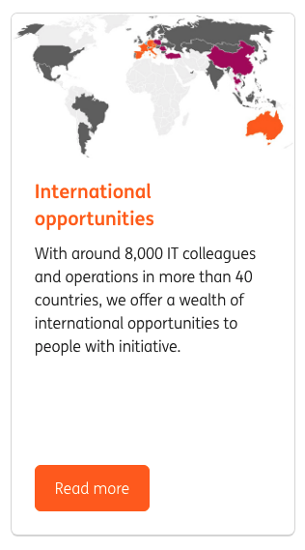
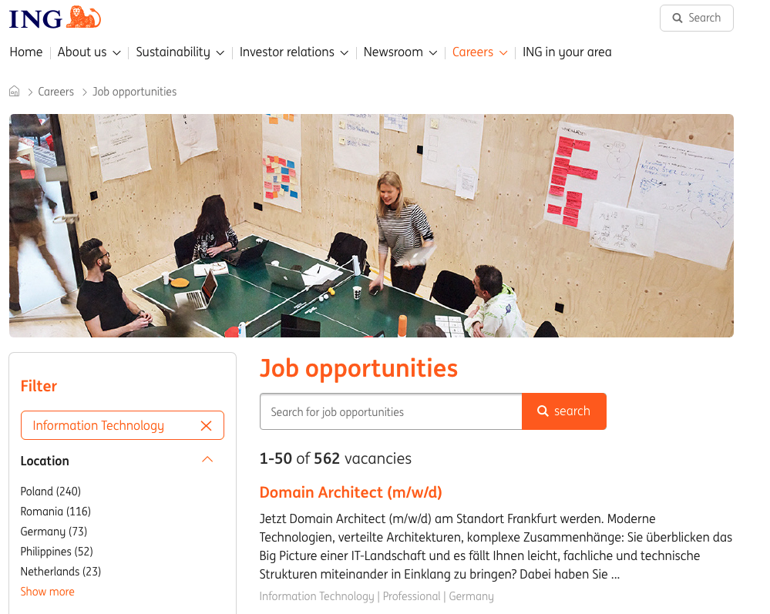
ING IT VAcancies
Source: website ING February 22, 2021

Slide 6

market
25 million
IT staff only
IT staff turnover is relatively high
Replacement cost estimate of 25.000 euros is relatively low
Replacement cost at large companies is higher (complex setup and systems)
yearly
Notes:
The Society for Human Resource Management (SHRM) estimates the average replacement cost of a salaried employee to be six to nine months’ salary. For an employee earning $60,000 per year, that totals approximately $30,000 to $45,000 in recruiting and training costs. Other studies have estimated this figure to be significantly higher — as much as twice the employee’s annual salary, especially for high-earner or executive level employees.
Source: https://mnwi.usi.com/Resources/Resource-Library/Resource-Library-Article/ArtMID/666/ArticleID/782/Cost-of-employee-turnover#:~:text=The%20Society%20for%20Human%20Resource,in%20recruiting%20and%20training%20costs.
ING IT staff turnover cost estimate:
12.4 % (turnover % 2019) * 8000 (# IT staff) * 25000 (replacement cost) =

Slide 7

solution
Hold on to people instead of replacing them
How: easy access and clear insight into the teams you can work for
Faster: spend less time assessing and training new people
Cheaper: save money on recruiting & reduce learning / adaptation time
Smarter: give your tech talent the opportunity to go where they sparkle brightest
Notes:
Instead of trying to recruit new tech talent, try to hold on to your current talent and put them where they are happy, most valuable & less likely to leave for greener pastures.
How: give people easy access and clear insight into the teams they can work in, what makes those teams exciting & what skills are needed
Faster: moving someone to a new team is much faster than hiring someone from outside
Cheaper: save money on recruiting, reduce learning time and team adaption time
Smarter: give your tech talent the opportunity to see and move to greener pastures within your company rather than force them outside

Slide 8
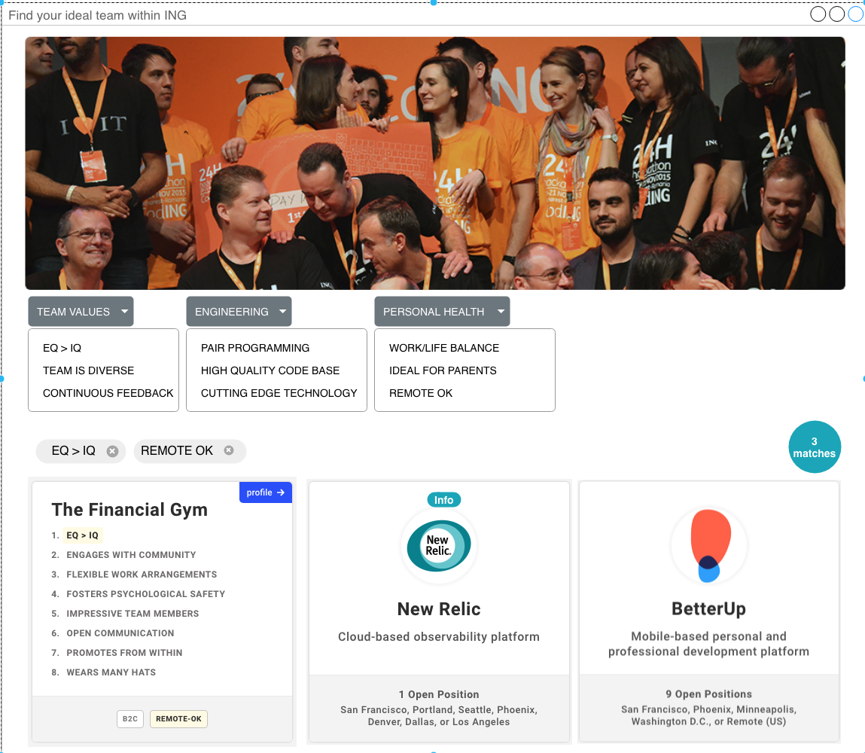
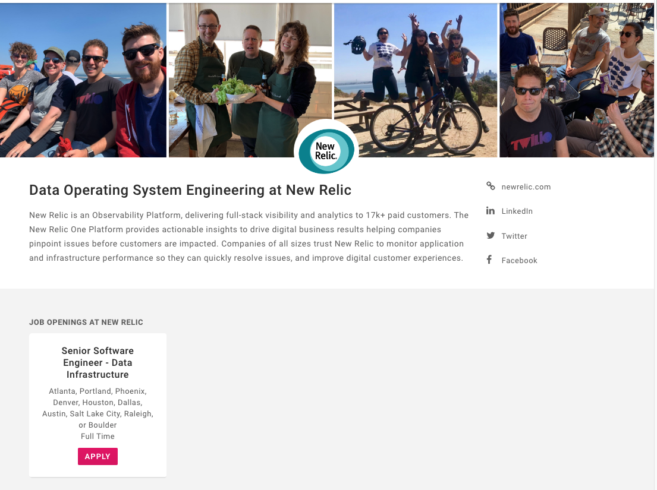
demo TIME
Find your team AND apply in 3 easy steps
3
1. find teams that share your values and interests
2. view the team profile
3. apply for a job

Slide 9
Business model
Subscription based model with fixed and variable component
10 euros per user per month (100 euros per year if paid upfront)
20 euros per month for maintaining a team profile page (200 euros per year if paid upfront)
250 euros for publishing a job (4 per team per year)
50 euros for a team job application (request) (2 applications per job)
500 euros for a succesful job application (1 succesful per team per year)
1000 IT teams at ING
EURO 1 MILLION (fixed)
1000 IT teams at ING
EURO 1.9 MILLION (variable)
3 MILLION
To break even 120 employees would need to stay one year longer (-1.5% turnover)
Notes:
# IT teams ING: 8000 (people) / team size (8) = 1000
Fixed cost per team:
200 (yearly fixed fee) * 1000 = 200.000
100 (yearly user fee) * 8000 = 800.000
Variable cost per team:
4 (published jobs per year): 1000 euros
8 job applications (2 per published job): 400 euros
1 succesful: 500 euros
Total: 1000 + 400 + 500 = 1900 per team
To break even ING would have to need 3.000.000 / 25.000 = 120 people to stay 1 year longer
In 2019 around 992 IT people left ING. 8000 * 12.4% = 992
If 120 people less would leave that would mean 872 people and a decrease in the employee turnover percentage of 1% (872 / 8000 * 100% = 10.9%). A decrease of 12.4 – 10.9 = 1.5%.

Slide 10
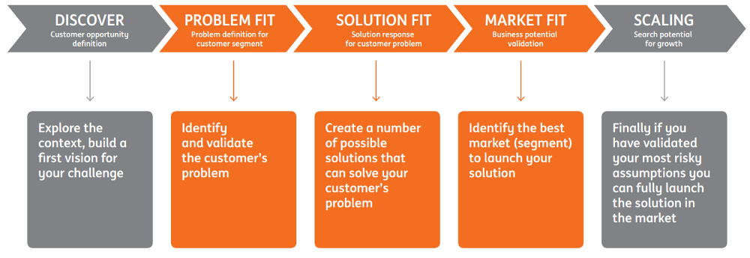
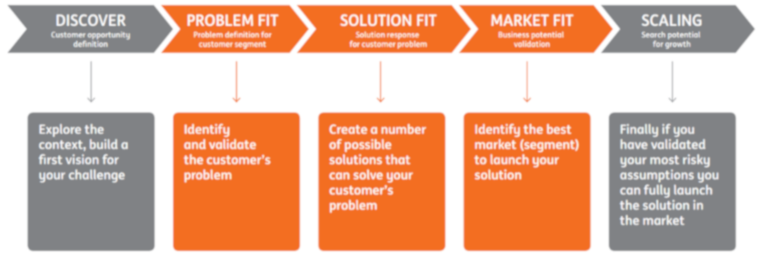
HOW to start: The pace way of working
GOAL: KILL NON VIABLE IDEAS QUICKLY!
Notes:
PACE is how ING named its way of working. It combines Design Thinking, Lean Startup and Agile methods into an approach tailored to ING’s needs.
PACE compels us to validate problems and solutions with our customers continuously to increase our chances meeting their needs.
PACE encourages rapid launch of new products and services developed by small, autonomous and cross disciplinary teams.
Killing non viable ideas quickly is also another crucial facet of PACE.
Above are the phases of the PACE way of working.
Discover
So…you have a challenge. This phase is about putting that challenge into context.
Scanning the broader environment to identify the opportunities, threats and constraints that will shape your vision for how to approach the challenge.
Looking at trends in consumer behaviour and markets, technology developments, regulation, competitors and what’s happening internally in order to uncover the potential customer opportunity.
Key outcomes
Prioritised list of potential opportunities, threats, solutions, promising customer segment(s), business models
Prioritised list of the riskiest hypothesis to be validate in next phase:
Customer — Value hypothesis / what people desire?
Business — Growth hypothesis / what is financially Viable?
Technology / Organisation — Tech/Org hypothesis / What is technologically / organisationally feasible?
Problem Fit
The objective of this phase is to define what is the problem that is worth solving and for whom we are solving it.
Many initiatives fail not because they don’t work, but because they solve problems that either don’t exist or are not important.
By determining how significant the problem is to your chosen customer you also validate whether or not the initiative represents a business opportunity.
In this phase you build and test prototypes to help validate your hypotheses and define requirements for building a Minimum Viable Product (MVP) in next phase.
Prototypes are created as quickly and with as little investment as possible as they are typically discarded after each test is complete.
Key outcomes:
Validated Customer problem
Customer: “I have this problem and would like it to be solved”
Solution Fit
The aim of this phase is to define the solution that best solves the customer problem.
Through experimentation, you design and validate various features of your solution, iterating toward the solution most favoured by your customer. This helps you decide the MVP to build, offer and test with customers.
Key outcomes:
Validated solution (offer and value)
Customer: “I want this solution, where can I buy it?”
Market Fit
During this phase you build and launch the actual product and associated services.
This allows you to validate the business model of your initiative in an actual market and ascertain the commercial potential for your initiative based on the size of the customer segment(s).
This is typically the most difficult and uncertain of the PACE phases: you are simultaneously iterating your solution and searching for a repeatable and scalable business model.
Key outcomes:
Validated MVP and market
Customer: “I repeatedly use and recommend this solution to others”

Slide 11
KEY ASSUMPTIONS
The most valuable people are most likely to leave (some turnover is desirable)
People can be convinced to stay if they are able move internally
Teams are willing to invest time to create a team profile page
Teams are / or someone else can pay for this initiative so it becomes viable
People are interested in moving more frequently
People think life is too short to work in a team where they are not happy
Teams are not too worried about loosing valuable people

Slide 12
The pace way of working
GOAL: KILL NON VIABLE IDEAS QUICKLY!
Notes:
PACE is how ING named its way of working. It combines Design Thinking, Lean Startup and Agile methods into an approach tailored to ING’s needs.
PACE compels us to validate problems and solutions with our customers continuously to increase our chances meeting their needs.
PACE encourages rapid launch of new products and services developed by small, autonomous and cross disciplinary teams.
Killing non viable ideas quickly is also another crucial facet of PACE.
Above are the phases of the PACE way of working.
Discover
So…you have a challenge. This phase is about putting that challenge into context.
Scanning the broader environment to identify the opportunities, threats and constraints that will shape your vision for how to approach the challenge.
Looking at trends in consumer behaviour and markets, technology developments, regulation, competitors and what’s happening internally in order to uncover the potential customer opportunity.
Key outcomes
Prioritised list of potential opportunities, threats, solutions, promising customer segment(s), business models
Prioritised list of the riskiest hypothesis to be validate in next phase:
Customer — Value hypothesis / what people desire?
Business — Growth hypothesis / what is financially Viable?
Technology / Organisation — Tech/Org hypothesis / What is technologically / organisationally feasible?
Problem Fit
The objective of this phase is to define what is the problem that is worth solving and for whom we are solving it.
Many initiatives fail not because they don’t work, but because they solve problems that either don’t exist or are not important.
By determining how significant the problem is to your chosen customer you also validate whether or not the initiative represents a business opportunity.
In this phase you build and test prototypes to help validate your hypotheses and define requirements for building a Minimum Viable Product (MVP) in next phase.
Prototypes are created as quickly and with as little investment as possible as they are typically discarded after each test is complete.
Key outcomes:
Validated Customer problem
Customer: “I have this problem and would like it to be solved”
Solution Fit
The aim of this phase is to define the solution that best solves the customer problem.
Through experimentation, you design and validate various features of your solution, iterating toward the solution most favoured by your customer. This helps you decide the MVP to build, offer and test with customers.
Key outcomes:
Validated solution (offer and value)
Customer: “I want this solution, where can I buy it?”
Market Fit
During this phase you build and launch the actual product and associated services.
This allows you to validate the business model of your initiative in an actual market and ascertain the commercial potential for your initiative based on the size of the customer segment(s).
This is typically the most difficult and uncertain of the PACE phases: you are simultaneously iterating your solution and searching for a repeatable and scalable business model.
Key outcomes:
Validated MVP and market
Customer: “I repeatedly use and recommend this solution to others”

Slide 13
So, how to start?
Test key assumptions and formulate new ones
Talk to Product Owners and Chapter Leads (ING uses the Spotify model)
Talk to people who recently left
Talk to HR and recruitment
Talk to people who recently changed team
Validate assumptions while talking to people and create new assumptions
Learn from all those who you to talk in order to learn more
Summarize: learn, learn, learn …

Slide 14
BUT who are you?
Not someone brilliant
Not the one who can sell water as if it is wine
Not the one who pretends to know all the answers
But someone who is committed to making sure people are happy where they work
But someone is eager to learn
Who has seen at ING that higher team mobility is possible
Who has failed before and learned from it

Slide 15
thank you!

Slide 16


traction
5
Teams with a profile
I never realized we had so much tech talent at ING. It’s good to see people are excited to move around within our company instead of leaving
I never realized we had so much tech talent at ING. It’s good to see people are excited to move around within our company instead of leaving
200
active users
Marco van Dam Chapter Lead, ING
Marco van Dam Chapter Lead, ING
2
hopped between teams
70%
Gross happiness

Slide 17
Process: transparency first
Agile all the way
Fail fast
Dashboard with important KPIs
Frequent milestones
Build learning into the solution
Notes:
Agile all the way:
If have always worked in an agile way. Even I was still studying in university I already did a project where every week I would meet up with a manager at a market research company to show what I made. At an American telecom company I would go around the building to disucuss ideas they had, implement and demo them and it felt empowering.
Build learning into the solution:
if someone visits the website, but leaves after only a few clicks I would like to know why
If a team does not create a profile I would like to know why
If someone leaves ING (a person disappears from the team in the product) I want to be informed and I want to him / her
Etc.

Slide 18
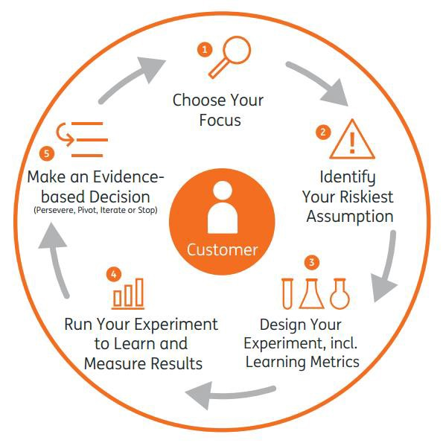
How to start again

Slide 19

Customer/User (ALT Slide)
Who they are and how many people can your reach with your solution? How will you reach/acquire them?

Slide 20


Competition
Know every competitor and what are the current solutions to this problem, and why they aren’t addressing your market adequately. List the major competitors, understand their processes and what your competitive advantage is.
Key: The wrong answer is, “I have no competition”.

Slide 21

Go To Market
300k
25
users
slam dunks
How you will acquire and retain customers, profitably, at scale, and keep your product competitive. Replace these stats with your own.
Key: Show how will you get terminal velocity.
4M
1,000
sales within first year
hours of fun

Slide 22

team
The team that has the experience and expertise to transform your opportunity into a large, profitable business. We want to know what qualifies you to execute your idea successfully and better than the five other companies in your space: work history, network, and skills are all key.
Key: Your history is important: did you work together in a prior company or did you meet last week at a hackathon? At an early stage, the key driver of our investment is the people, particularly how hungry and coachable you are.

Slide 23


team members
First Last
First Last
First Last
First Last
position
position
position
position
Biography for team member, highlighting their experience in their role and what motivates their work.
Biography for team member, highlighting their experience in their role and what motivates their work.
Biography for team member, highlighting their experience in their role and what motivates their work.
Biography for team member, highlighting their experience in their role and what motivates their work.

Slide 24

Financial Overview (ALT Slide)
What are the expected revenues, expenses, and EBITDA for the next three to five years.
Key: What are the expected revenues, expenses, and EBITDA three years out? How long will this round’s cash last you?

Slide 25

funding
300
$
How much are you raising and how are you going to use this money? To grow a team, to support overhead, to expand?
Key: Also address how you have gotten to where you are now. How much have you raised thus far and from whom?
thousand
(or any other amount) and what you will use the money for.

Slide 26
sources
https://fi.co/insight/read-this-checklist-before-pitching-to-a-venture-capitalist Author: David Teten, a Mentor for both the New York and Singapore Founder Institute Chapters
https://fi.co/insight/creating-a-startup-pitch-deck-start-with-this-easy-to-use-template Author: Malcolm Lewis, a Mentor for the Orange County Founder Institute.
https://fi.co/insight/these-are-the-4-most-important-pitch-deck-templates-you-need Author: Founder Institute

